Slide 1

BT1010 Introduction to Life Sciences
Lecture 2: Biomolecules: Proteins and Enzymes
27/10/2025
Course Instructor:
Dr. Gunjan Mehta, Ph.D.
Assistant Professor
BT314, Department of Biotechnology
IIT Hyderabad
(M.) +91 70168 96886 Email: gunjanmehta@bt.iith.ac.in

Slide 2
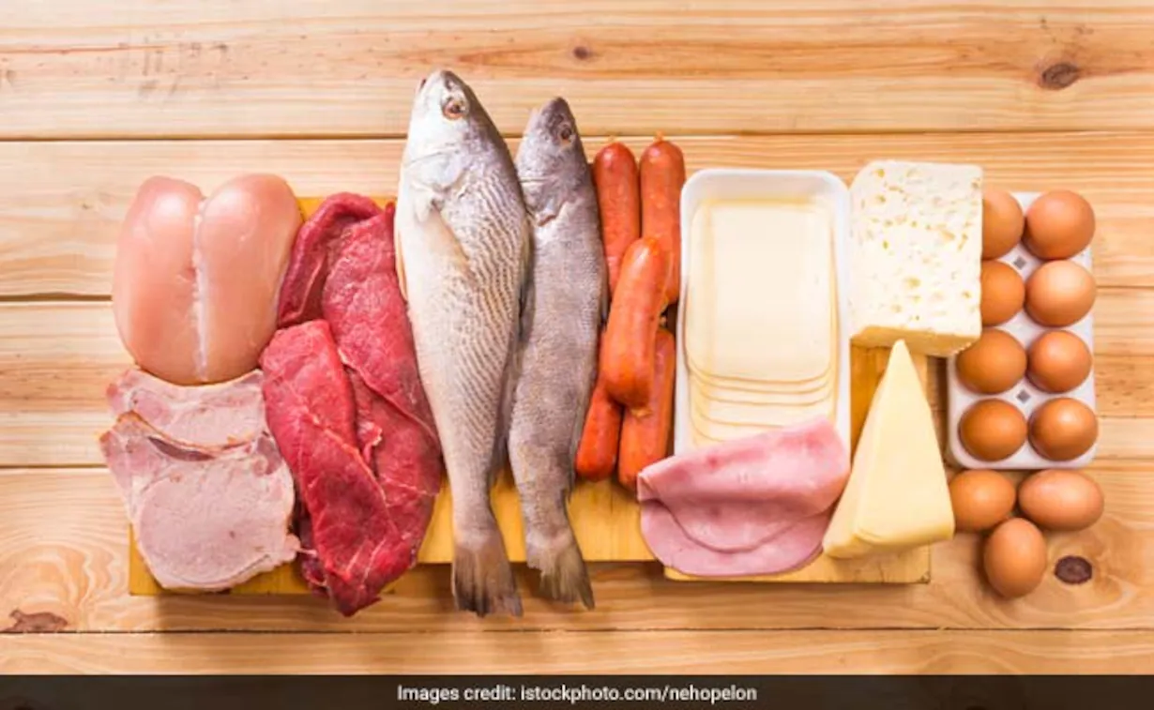
Proteins

Slide 3
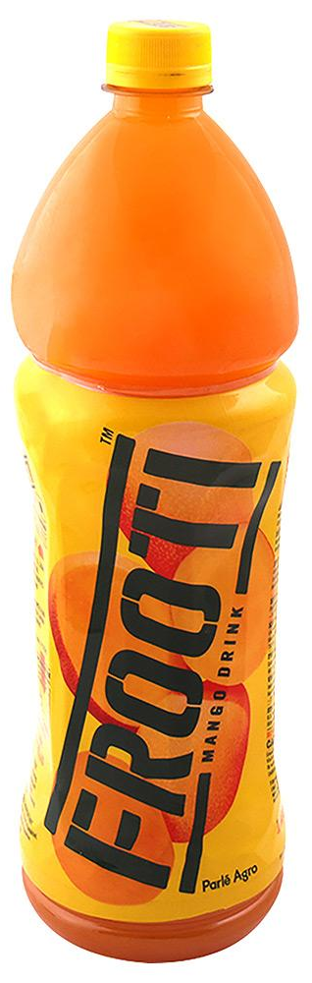
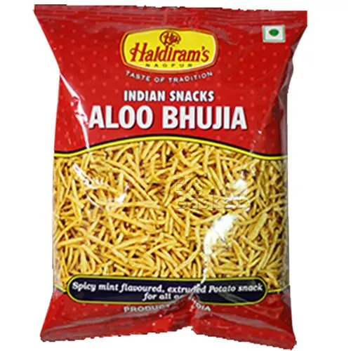
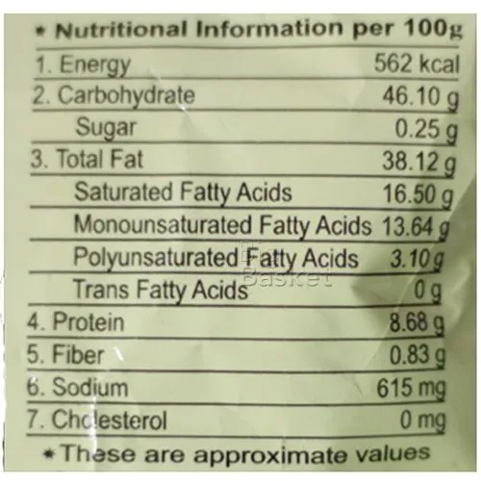
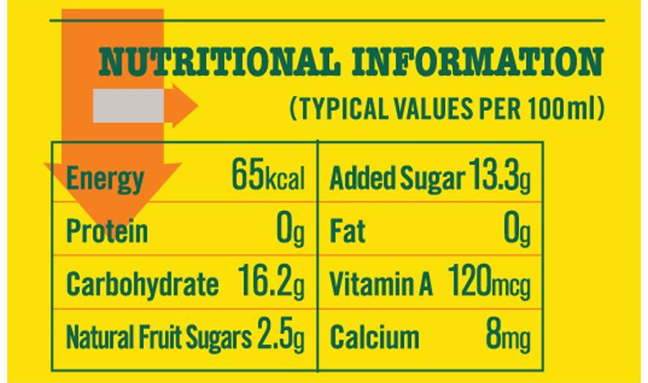
Types of biomolecules that we eat.
16.2 gm x 4 = 65 cal
46.10 gm x 4 = 184.4 cal
8.68 gm x 4 = 34.72 cal
38.12 gm x 9 = 343.08 cal
Total = 562 cal
1 gm of carbohydrates provide 4 calories.
1 gm of proteins provide 4 calories
1 gm of fats/lipids provide 9 calories
Note: Nutritional calorie is the equivalent of the kilocalorie used by chemists and biochemists. So, 65 calorie diet is the equivalent of a 65 kcal diet.

Slide 4
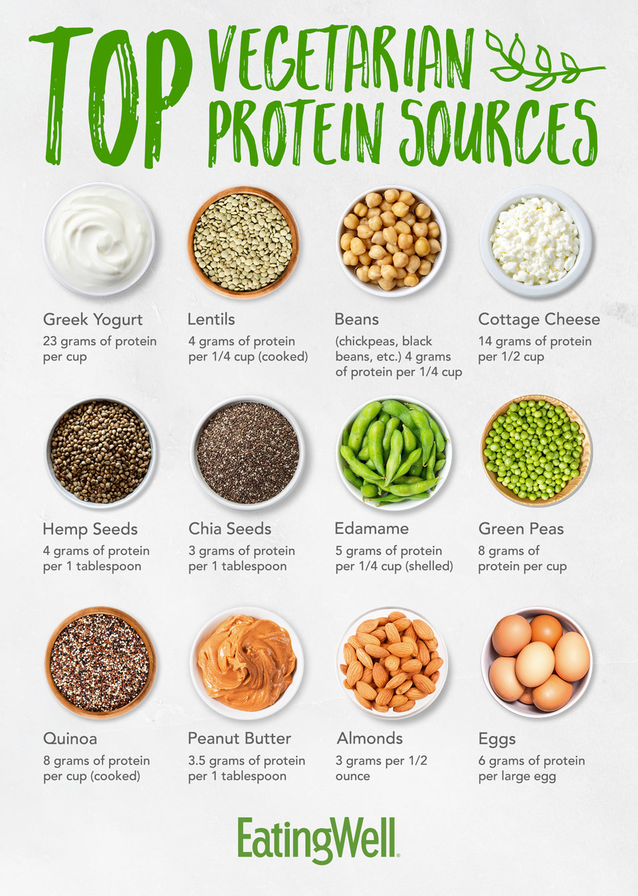
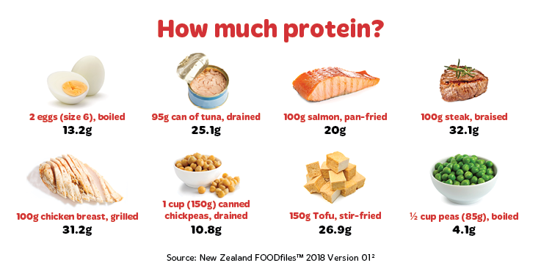

Slide 5
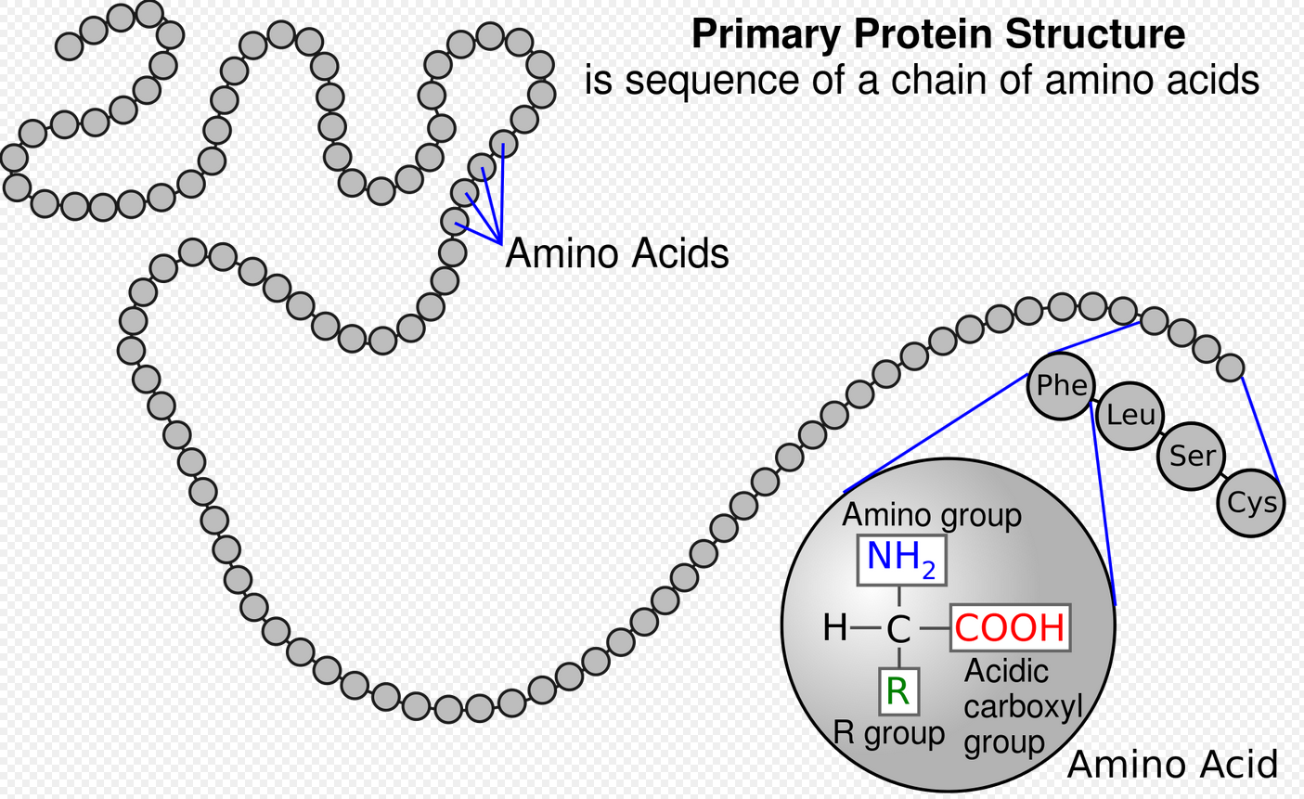
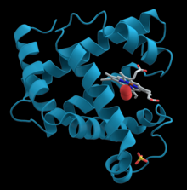
What are proteins?
Proteins are large biomolecules and macromolecules that comprise long chains of amino acids, linked by the peptide bond.
Proteins perform a vast number of functions in our body such as catalysing metabolic reactions, DNA replication, providing structural support to the cells, transporting molecules.
Proteins are nanomachines of the cells.
Motor protein walking on a microtubule: https://www.youtube.com/watch?v=y-uuk4Pr2i8
https://www.youtube.com/watch?v=wJyUtbn0O5Y
A representation of the 3D structure of the protein myoglobin showing turquoise α-helices. This protein was the first to have its structure solved by X-ray crystallography. Toward the right-center among the coils, a prosthetic group called a heme group (shown in gray) with a bound oxygen molecule (red).

Slide 6
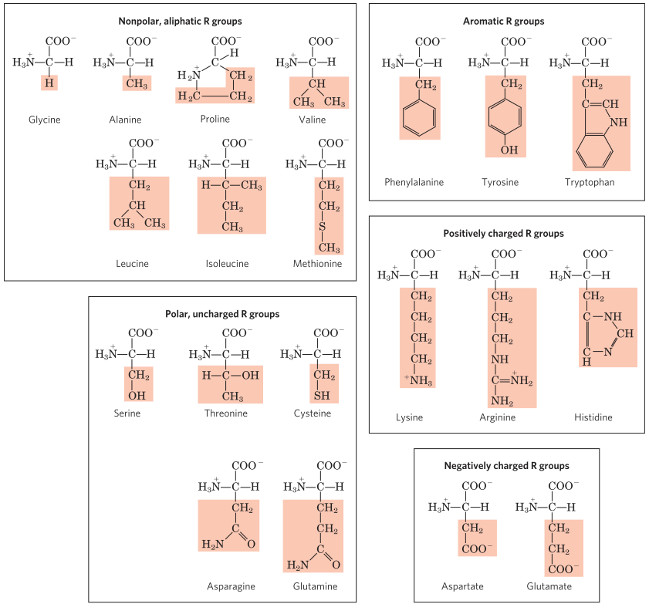
The 20 common amino acids of proteins
Amino acids are organic compounds that contain amino (-NH3+) and carboxyl (-COO-) functional groups, along with a side chain (R group) specific to each amino acid.
They are classified based on their polarity, ionization and side chain group type (aliphatic, acyclic, aromatic).
Natural amino acids have the L configuration.
There are several Uncommon amino acids such as 4-hydroxyproline, 5-hydroxylysin, 6-N-Methyllysine, Selenocystein. See page no. 82 in Lehninger.

Slide 7
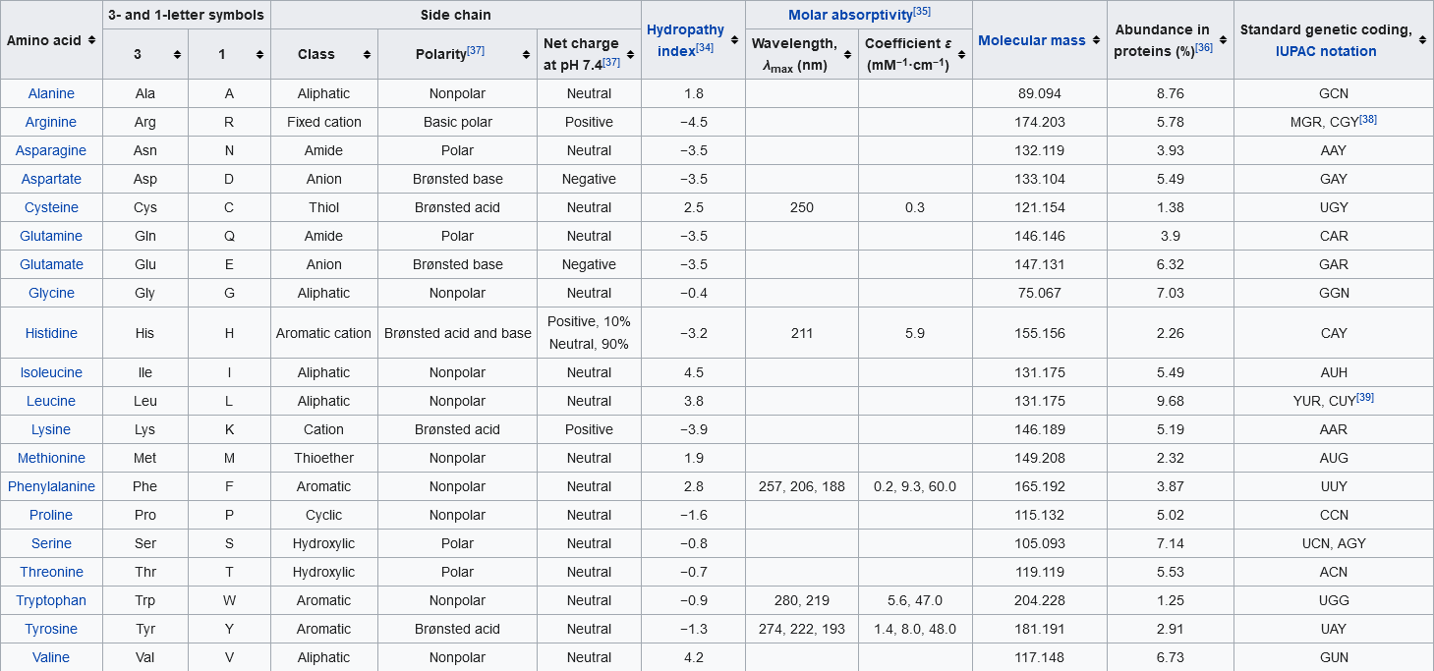
Table of standard amino acid abbreviations and properties

Slide 8
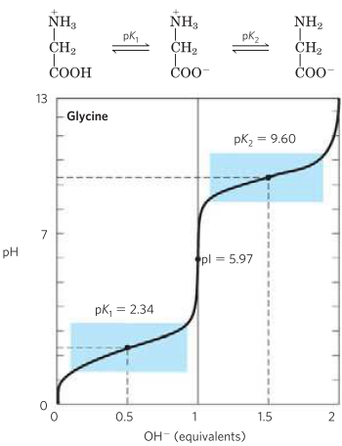

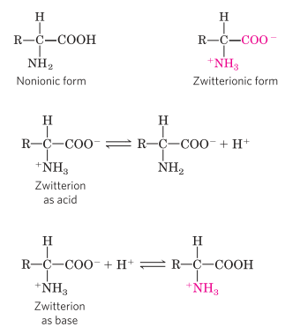


Amino Acids have characteristic titration curves
Amino acids have two ionizable groups, the carboxyl group and the amino group.
When you titrate with a strong base (NaOH), the plot shows two distinct stages, corresponding to deprotonation of two different groups of the amino acids.
The pKa is a measure of the tendency of a group to give up a proton, with that tendency decreases tenfold as the pKa increases by one unit.
For Glycine, pKa of COOH group is 2.34, whereas pKa of NH2 group is 9.6
The carboxyl group of glycine is over 100 times more acidic (more easily ionized) than the carboxyl group of acetic acid (pKa = 4.76).
The titration curve of glycine indicates that this amino acid has two regions of buffering power. One of these is the relatively flat portion of the curve, 1 pH unit on either side of the pK₁ of 2.34 and the second one is near pK₂ of 9.60.

Slide 9

Titration curve predict the electric charge of amino acids
At pH 5.97, glycine is present predominantly as its dipolar form, fully ionized but with no net electrical charge.
The characteristic pH at which the net electric charge is zero is called the isoelectric point or isoelectric pH, designated pI. At this pH, the amino acid exists in its zwitterionic form.
However, amino acids differ in their acid-base properties, based on the ionization capacity of the R group. The titration curve of all the amino acids are not the same. See page no. 84-85 in Lehninger. Titration curves for glutamate and histidine.

Slide 10
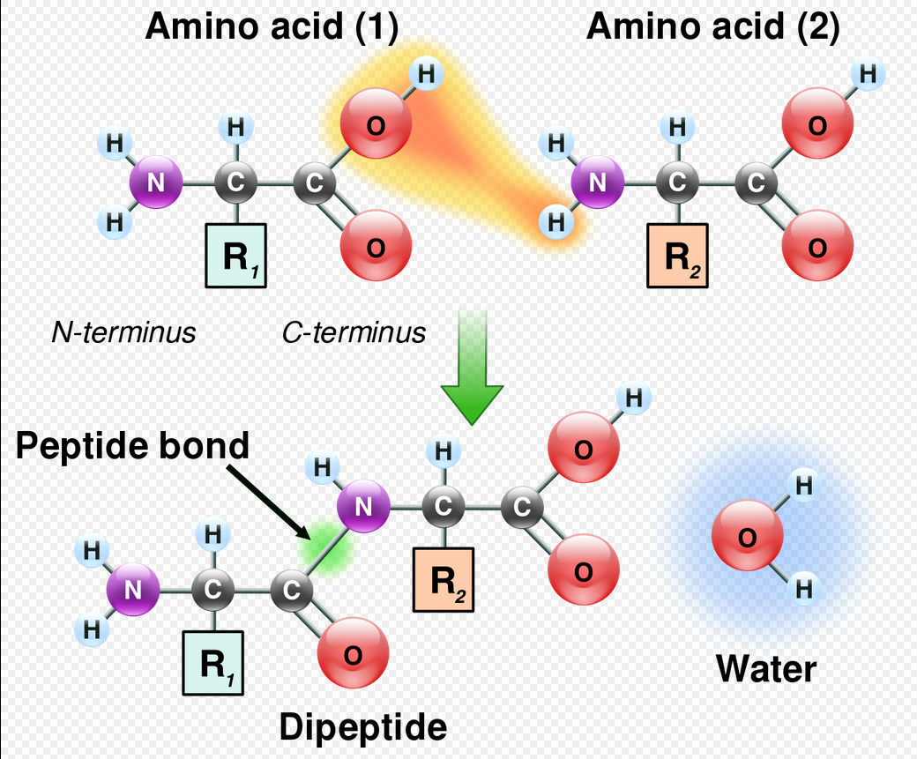
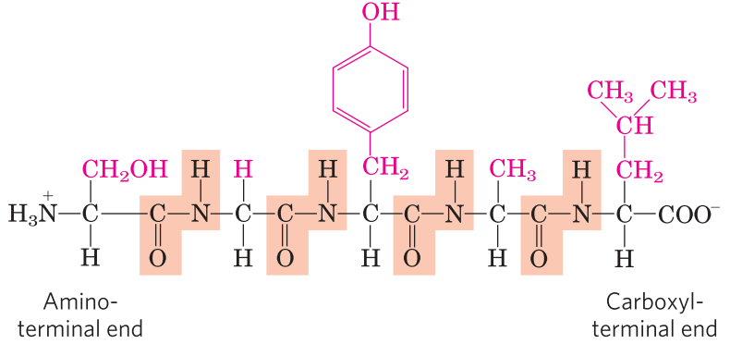
Peptides and Proteins
Amino acids are linked together by the peptide bond to form a peptide (two/three/four/five amino acids)/oligopeptide (a few amino acids)/polypeptide (many amino acids)/protein (thousands of amino acids).
The pentapeptide, Ser-Gly-Tyr-Ala-Leu, or SGYAL

Slide 11
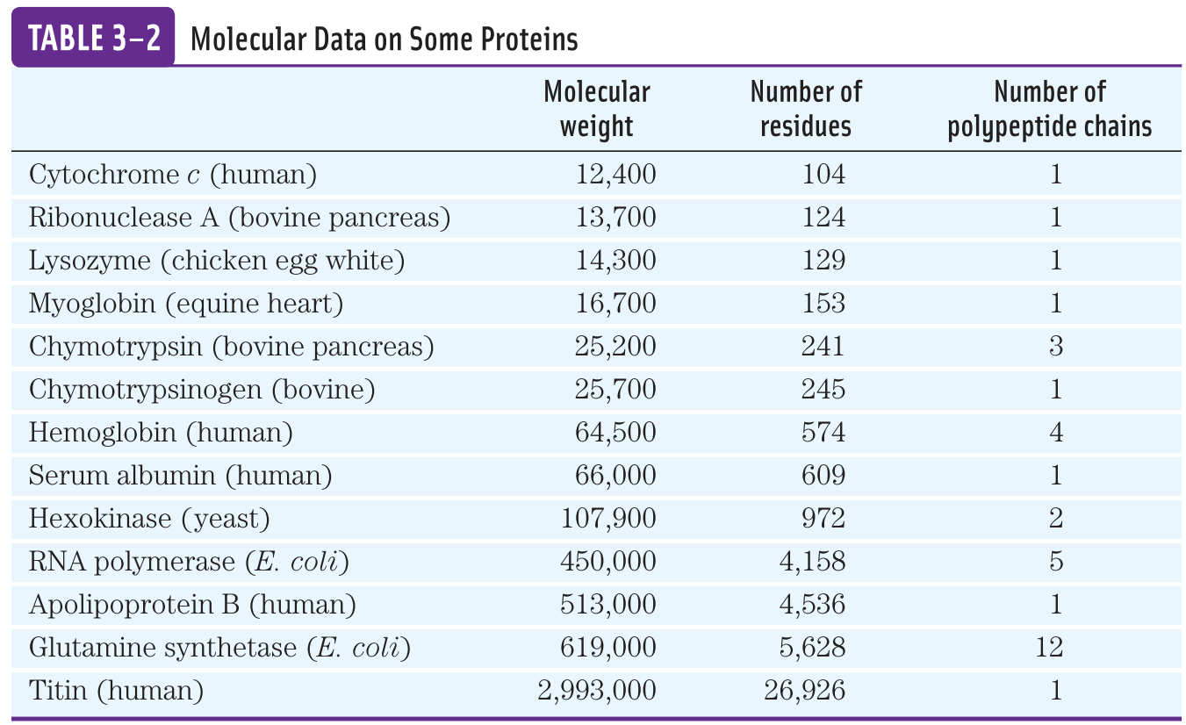

Slide 12
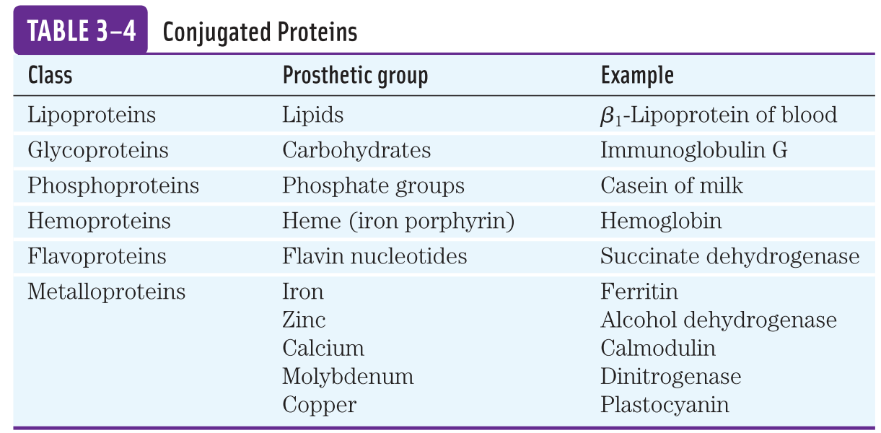
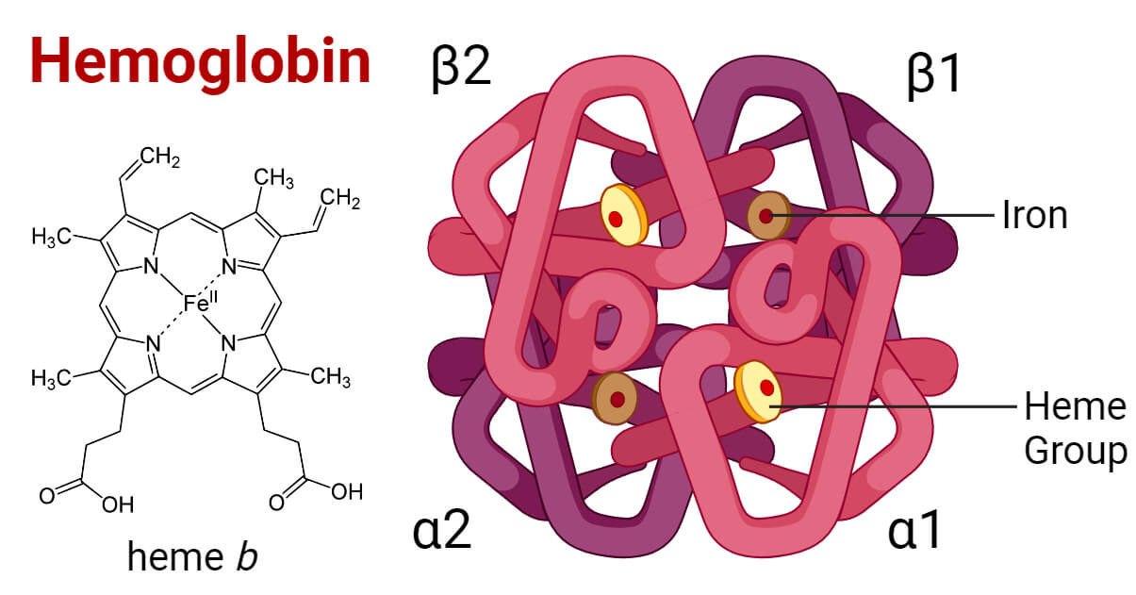
Prosthetic group
Some proteins contain chemical groups other than amino acids. This chemical group is known as prosthetic group.

Slide 13
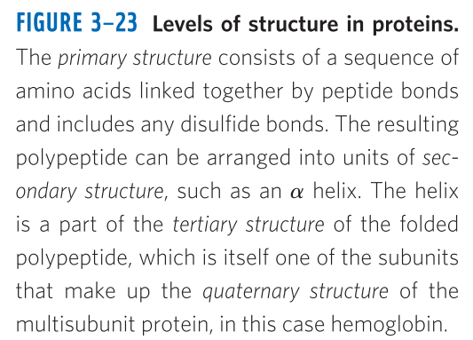
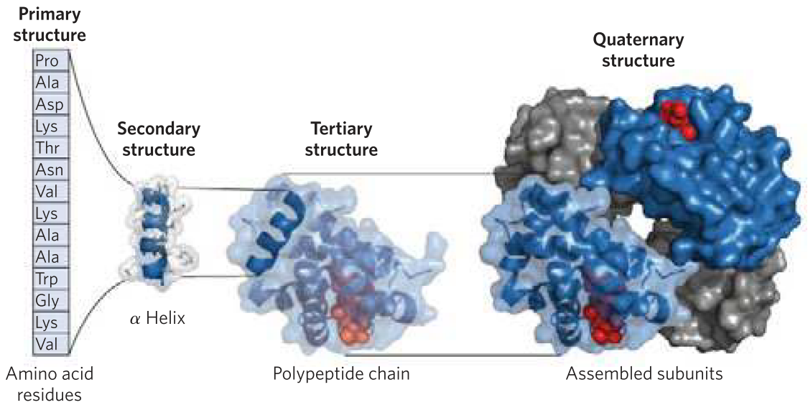
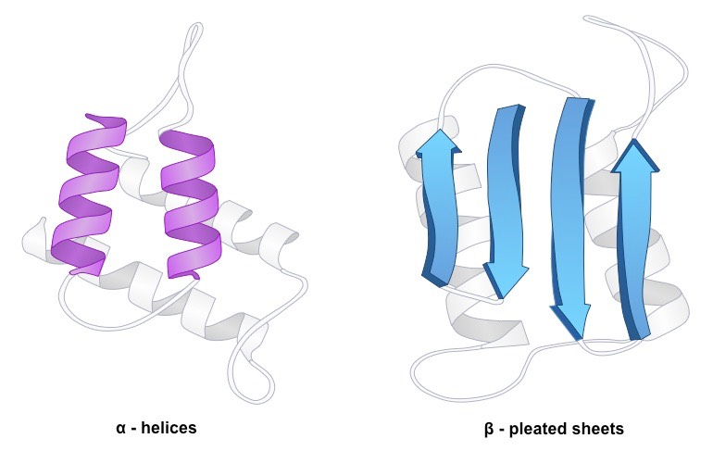
The structure of proteins
Primary structure: the linear sequence of amino acids: Gly-Ala-Lys-Trp
Secondary structure: stable arrangement of amino acids giving rise to recurring structural patterns, such as α-helix and β-sheet.
Tertiary structure: three-dimensional folding of a polypeptide chain.
Quaternary structure: when a protein has two or more polypeptide chains, their arrangement in space.
α-helix
β-sheet

Slide 14
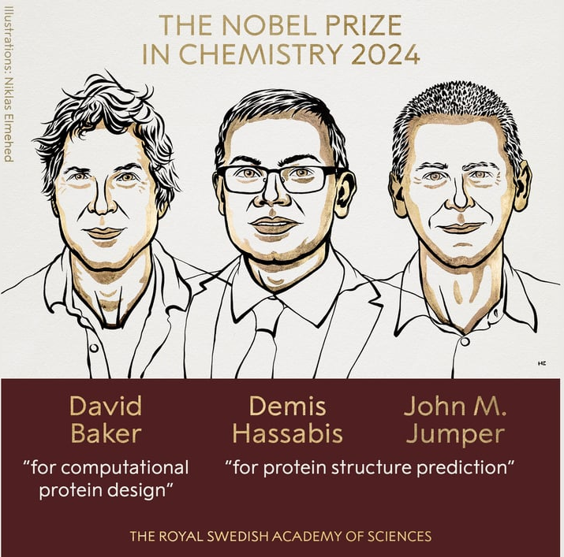
Nobel prize 2024 in Chemistry for AI-based protein structure prediction tool (Alpha Fold)
Demis Hassabis, John Jumper and David Baker for being awarded the 2024 Nobel Prize in Chemistry for their work on protein structure prediction and computational protein design.
Artificial intelligence pioneer Demis Hassabis, whose AI software cracked an impossible chemistry problem—predicting the structure of every protein known to science.
John Michael Jumper (born 1985) is an American chemist and computer scientist. He currently serves as director at Google DeepMind.^{[2][3][4]} Jumper and his colleagues created AlphaFold,^{[5]} an artificial intelligence (AI) model to predict protein structures from their amino acid sequence with high accuracy.
David Baker is an American biochemist and computational biologist who has pioneered methods to design proteins and predict their three-dimensional structures.

Slide 15
Our Hairs and Nails are proteins
Our hairs and nails are made up of a protein, known as ɑ-Keratin. Hair grows at a rate of 15-20 cm/year, whereas nails grow 3.5 mm each month.
The fundamental structural element of ɑ-Keratin is the ɑ-helix.

Slide 16
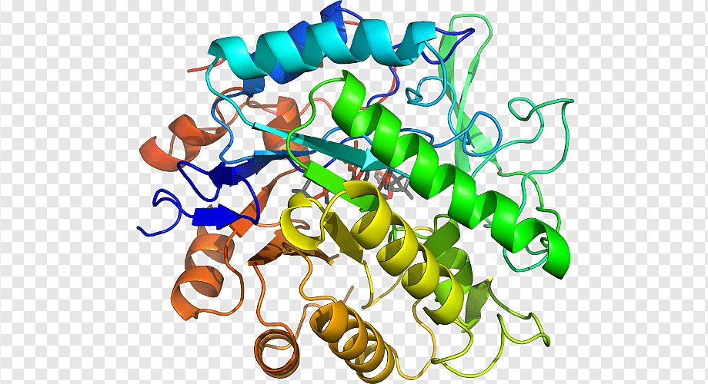
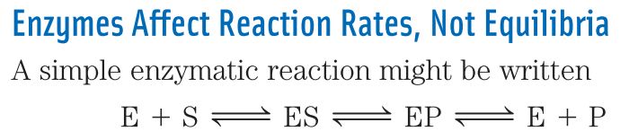
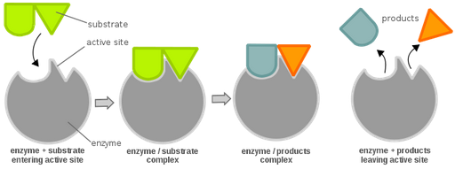
What are Enzymes?
Enzymes are proteins.
Enzymes are bio-catalysts.
Catalysts accelerate chemical reactions. Similarly, enzymes accelerate biochemical reactions.
Like all catalysts, enzymes increase the reaction rate by lowering its activation energy.

Slide 17
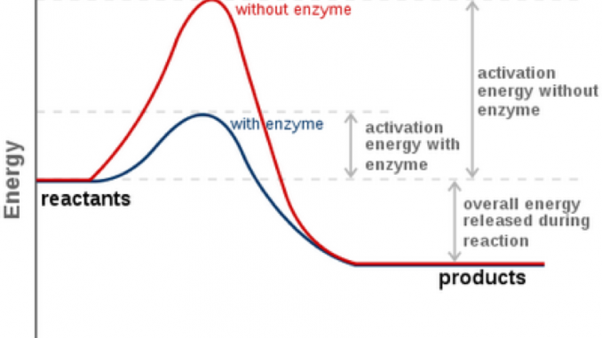
Activation Energy
Activation Energy: the difference between the energy levels of the ground state and the transition state is known as the activation energy (ΔG).
Enzymes enhance the reaction rate by lowering activation energy.

Slide 18
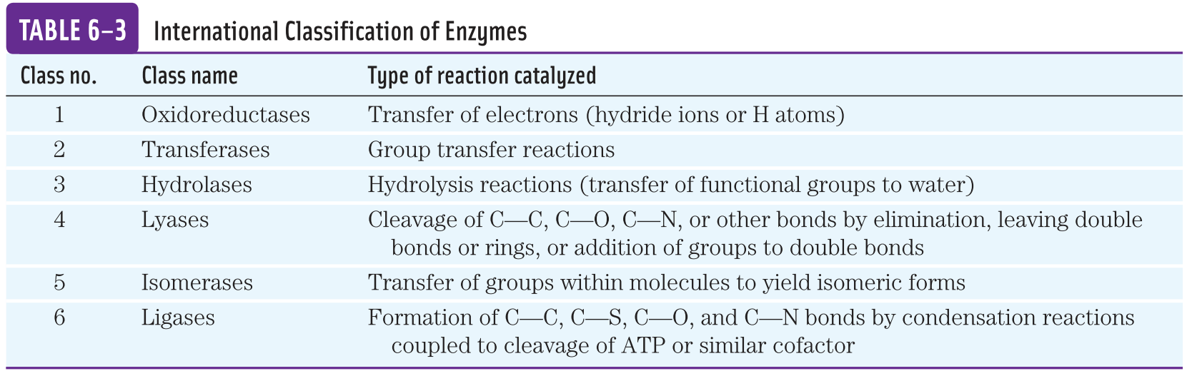
International Classification of Enzymes
Enzymes are classified according to the type of reaction they catalyze.

Slide 19
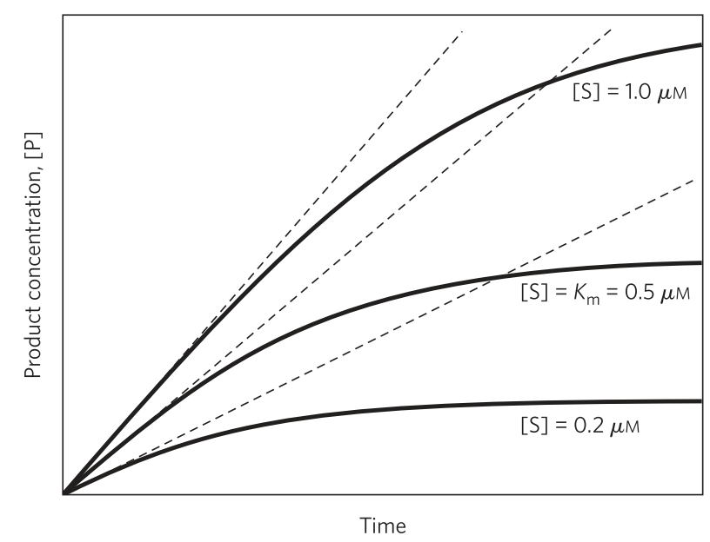
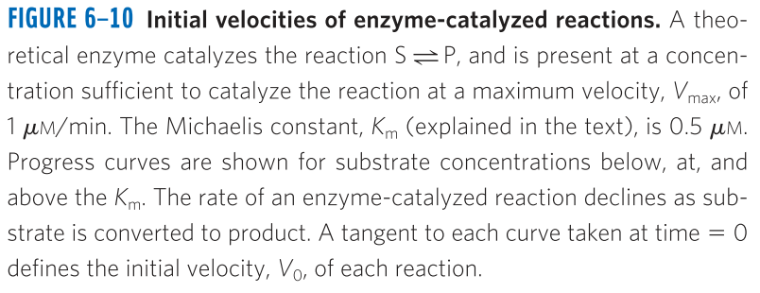
Enzyme Kinetics
Substrate concentration [S] affects the rate of enzyme-catalyzed reactions.
However, the substrate concentration [S] keeps changing in the enzymatic reaction as products are formed.
So, the initial velocity (Vo) is measured.

Slide 20
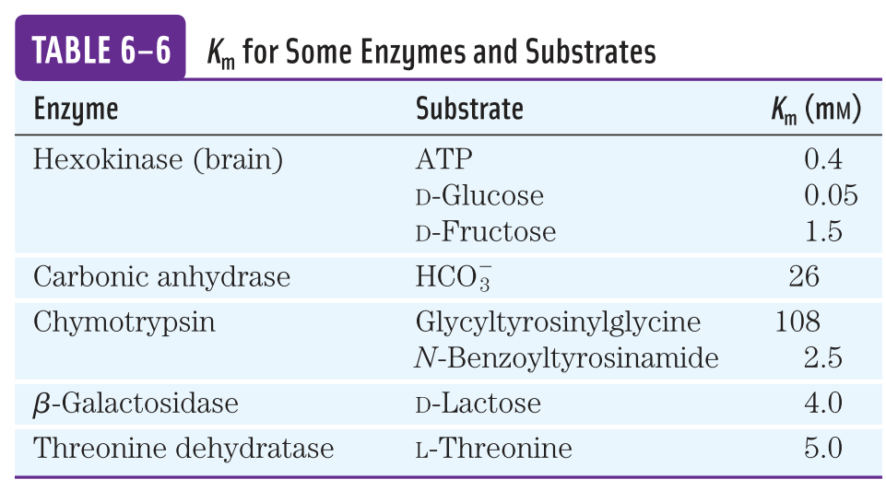
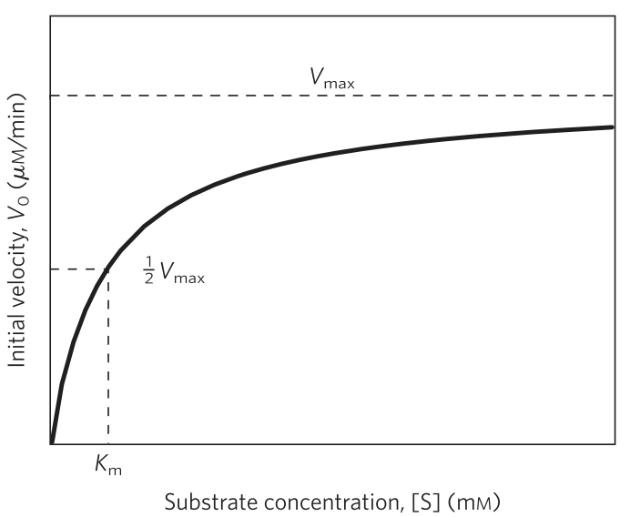
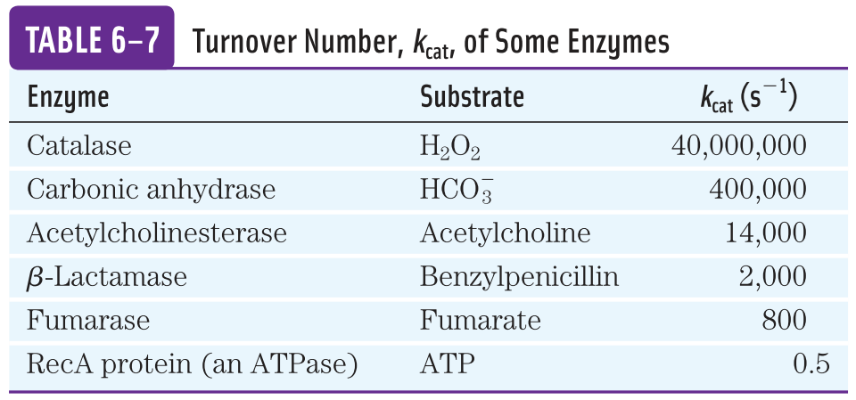
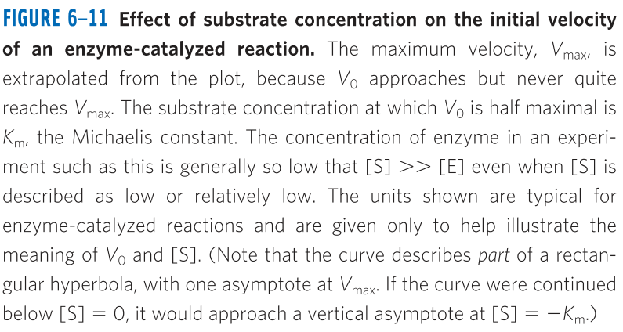
Kinetic parameters for an enzymatic reaction
The effect on V₀ of varying [S] when the enzyme concentration is held constant.
Rectangular Hyperbola curve
V_{max}= maximum velocity (unit µM/min)
K_{m}= The substrate concentration at which the velocity is Vmax/2. (unit mM)
K_{cat} = turnover number (the number of substrate molecules converted to product in a given unit of time on a single enzyme molecule when the enzyme is saturated with substrate. (unit s⁻¹)

Slide 21
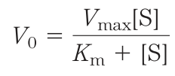
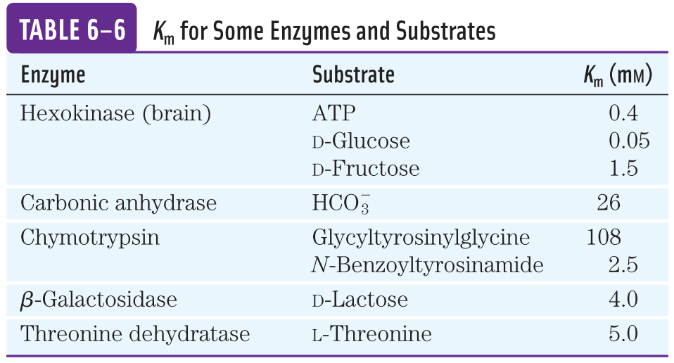
The relationship between Substrate Concentration [S] and Reaction Rate (V₀)
The rectangular hyperbola curve can be expressed algebraically by the Michaelis-Menten Equation.
The value of KM is inversely related to the affinity of the enzyme for its substrate. High values of KM correspond to low enzyme affinity for substrate (it takes more substrate to get to Vmax).
where, K_{m} is the Michaelis constant.

Slide 22


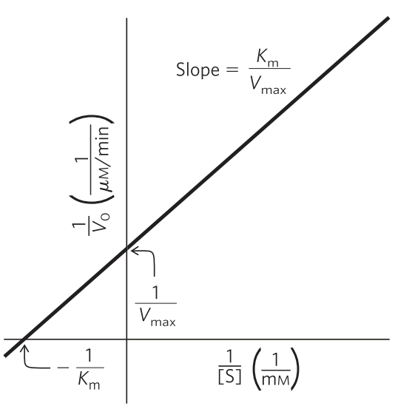
Lineweaver-Burk equation/plot for calculating Km and Vmax
Michaelis-Menten equation
Lineweaver-Burk equation
Transformed
Plot of 1/V₀ versus 1/[S] (double reciprocal) yields a straight line.
This line has a slope of K_{m}/V_{max}
Accurate determination of V_{max}

Slide 23
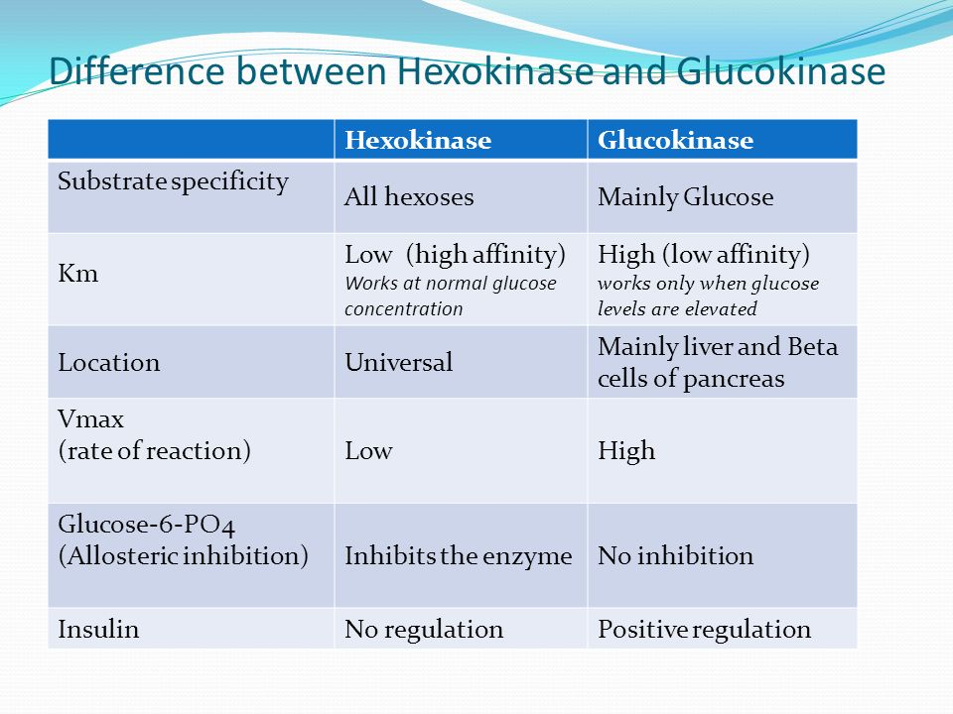
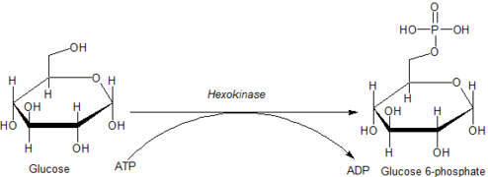
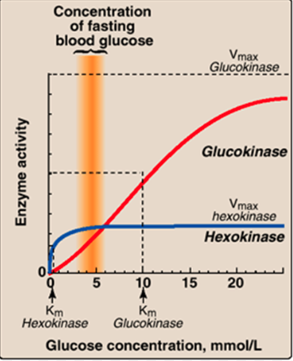
Enzymes with same function but different kinetics
Hexokinase and Glucokinase, both are enzymes that phosphorylates glucose.
Glucokinase

Slide 24
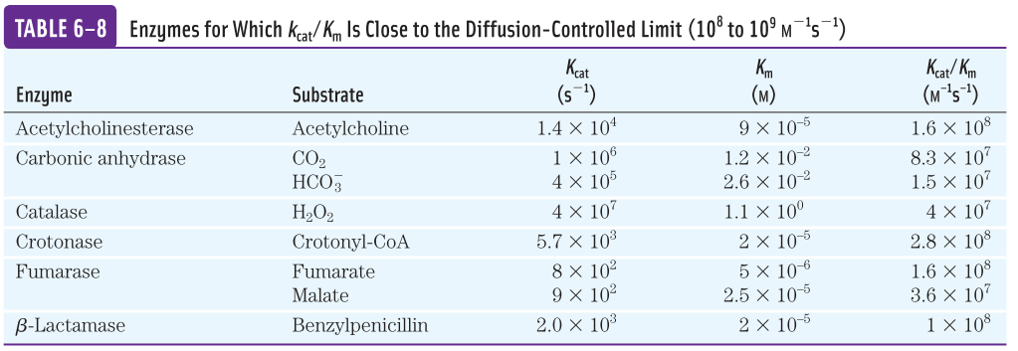
Comparing catalytic mechanisms and efficiencies of two different enzymes
The kinetic parameters K_{cat} and K_{m} are useful for comparing different enzymes.
The best way to compare the catalytic efficiencies of different enzymes or the turnover of different substrates by the same enzyme is to compare the ratio of K_{cat}/K_{m} for the two reactions.
This ratio is known as Specificity Constant.
The upper limit to K_{cat}/K_{m}, imposed by the rate at which E and S can diffuse together in an aqueous solution. This diffusion controlled limit is 10⁸ to 10⁹ M⁻¹s⁻¹.
Catalytic perfection

Slide 25
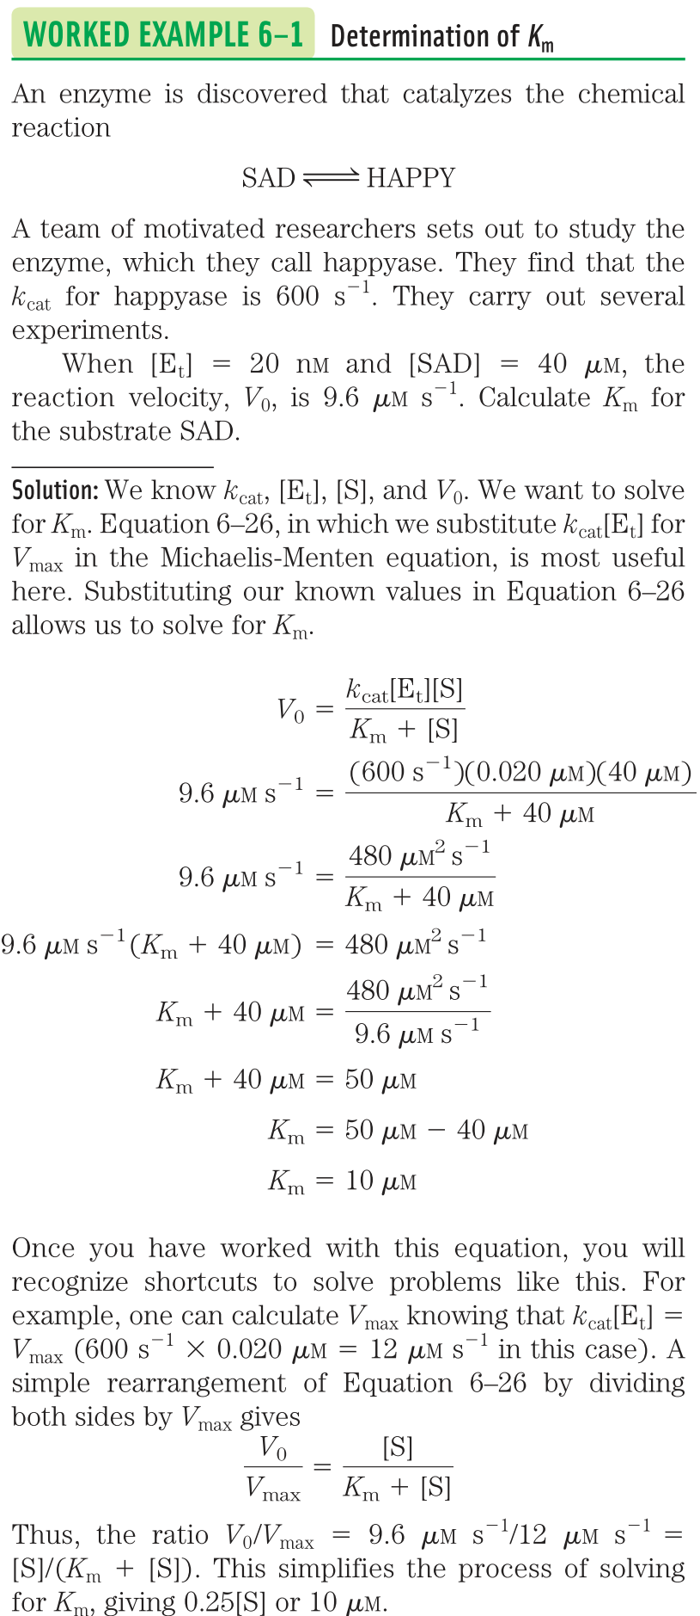

Slide 26
Further reading
Book: Lehninger: Principles of Biochemistry, 6th edition. ISBN: 1464109621.
Chapter 3: Amino Acids, Peptides, and Proteins, Page 75-114.
Chapter 4: Three dimensional structure of proteins, Page
Chapter 6: Enzymes
Next class on 30/10/2025 (Thursday)

